Slide 1
Notes:
This graph represents the percent of the U.S. Population by Age Group. This is a bar graph that shows the percentage of each gender within each age group and is animated through time. This bar graph begins at 0% in the middle and moves out positively left or right depending on the gender. Different colors are present to represent different groups in the data. The data spans from 1950-2060, showing that some of this data is predictive.

Slide 2
Age
Percentage
Notes:
The x-axis represents the quantitative variable population percentage. The y-axis represents the categorical variable age range. And gender is another categorical variable included as different colored bars on the plot.
The baby boomer population is also pointed out in this graph with darker bars.
The animation aspect allows you to see the change through time, while also being able to show the other attributes like percentage and age on the graph. The graph itself has a lot of information included within it.

Slide 3
Notes:
So, what is happening in this graph?
You can see that for the most part the populations for men and women are steadily the same. One major difference in the gender aspect is the adults and you can see that women often live longer, especially in the beginning of the time frame. However, you can see it begin to level out towards the end of the animation.

Slide 4
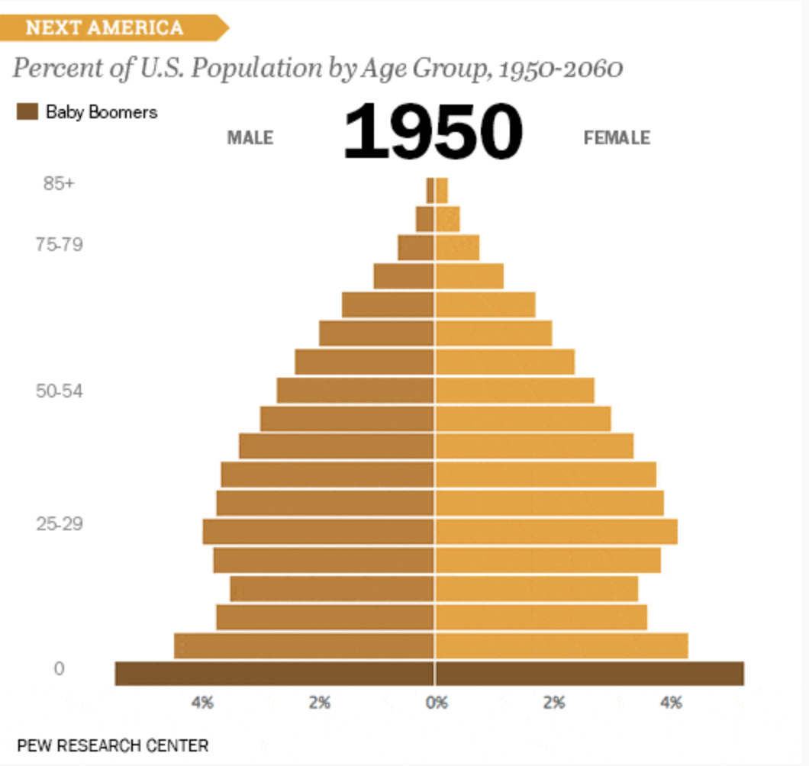
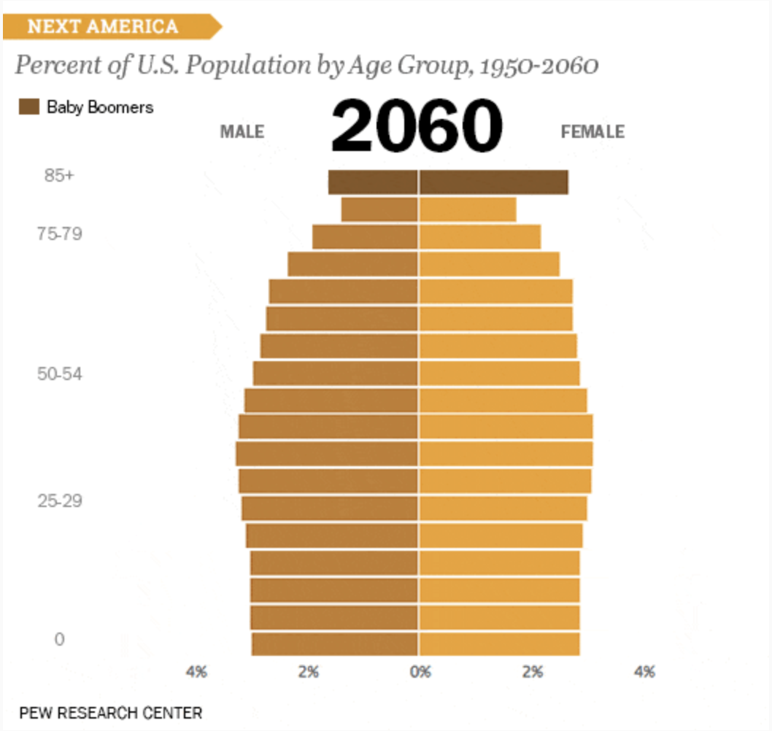
Notes:
You can see much more when you compare the first year to the last year in the graph. The change is very prevalent. In 1950 the graph showed a pyramid shape. This pyramid represents the younger population being larger and we know people did not live as long in the 1950s.
The end of the graphic shows a completely different shape, however. This is more of a rectangular shape, while converging towards the top of the graph. This shows a more evened out population.
It is important to note where the baby boomers fell during this animation because they were the beginning of the changes in population. You can see they start with many younger children. And since they started with a much bigger generation, they were able to even out the older age groups with the rest of the age groups as they grew older.
Through time there have been advances in the medical field, allowing people to live longer (which we can see through the changes in the top of the graph from the beginning of the animation to the end of the animation.

